Slide 1
Lecture 19
The Wavelet Transform

Slide 2

Some signals obviously have spectral characteristics that vary with time
Motivation

Slide 3
Criticism of Fourier Spectrum
It’s giving you the spectrum of the
‘whole time-series’
Which is OK if the time-series is stationary
But what if its not?
We need a technique that can “march along” a timeseries and that is capable of:
Analyzing spectral content in different places
Detecting sharp changes in spectral character

Slide 4

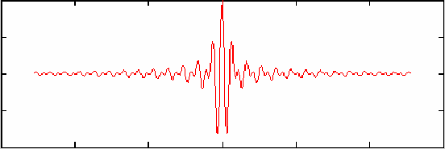
Fourier Analysis is based on an indefinitely long cosine wave of a specific frequency
time, t
Wavelet Analysis is based on an short duration wavelet of a specific center frequency
time, t

Slide 5
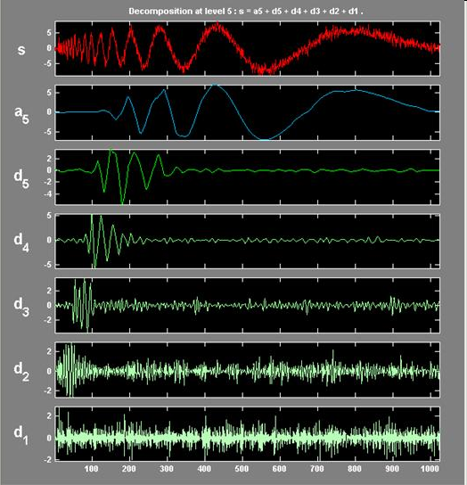

Slide 6
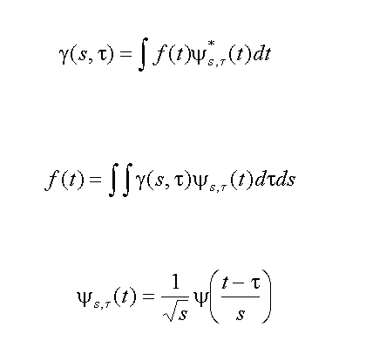
Wavelet Transform
Inverse Wavelet Transform
All wavelet derived from mother wavelet

Slide 7
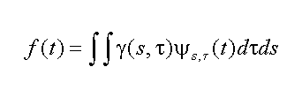

Inverse Wavelet Transform
time-series
wavelet with
scale, s and time, τ
coefficients
of wavelets
build up a time-series as sum of wavelets of different scales, s, and positions, τ

Slide 8
Wavelet Transform
I’m going to ignore the complex conjugate from now on, assuming that we’re using real wavelets
time-series
coefficient of wavelet with
scale, s and time, τ
complex conjugate of wavelet with
scale, s and time, τ

Slide 9
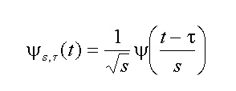
Wavelet
normalization
shift in time
change in scale:
big s means long wavelength
wavelet with
scale, s and time, τ
Mother wavelet

Slide 10
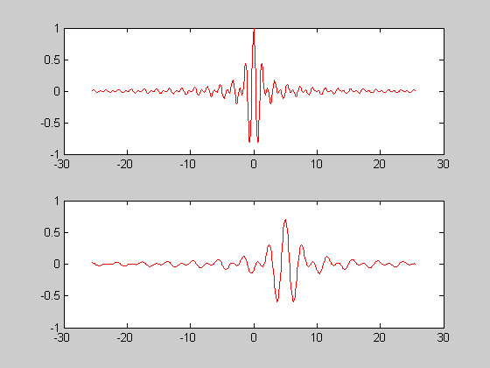
Shannon Wavelet
Ψ(t) = 2 sinc(2t) – sinc(t)
mother wavelet
τ=5, s=2
time

Slide 11
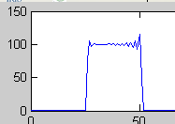

Fourier spectrum of Shannon Wavelet
frequency, ω
ω
Spectrum of higher scale wavelets

Slide 12
Thus determining the wavelet coefficients at a fixed scale, s can be thought of as a filtering operation γ(s,τ) = ∫ f(t) Ψ[(t-τ)/s] dt
= f(τ) * Ψ(-τ/s) where the filter Ψ(-τ/s) is has a band-limited spectrum, so the filtering operation is a bandpass filter

Slide 13

not any function, Ψ(t) will work as a wavelet
admissibility condition:
Implies that Ψ(ω)→0 both as ω→0 and ω→∞, so Ψ(ω) must be band-limited

Slide 14

a desirable property is γ(s,τ)→0 as s→0
p-th moment of Ψ(t)
Suppose the first n moments are zero (called the approximation order of the wavelet), then it can be shown that γ(s,τ)∝s^{n+2}. So some effort has been put into finding wavelets with high approximation order.

Slide 15
Discrete wavelets: choice of scale and sampling in time
s^{j}=2^{j}
and
τ_{j,k} = 2^{j}kΔt
Then γ(σ_{j},t_{j,k}) = γ_{jk}
where j = 1, 2, …∞
k = -∞… -2, -1, 0, 1, 2, …∞
Scale changes by factors of 2
Sampling widens by factor of 2 for each successive scale

Slide 16
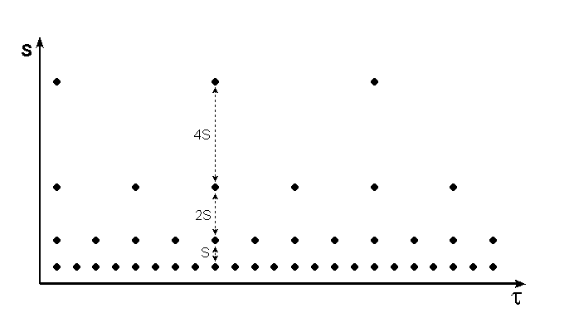
dyadic grid

Slide 17
The factor of two scaling means that the spectra of the wavelets divide up the frequency scale into octaves (frequency doubling intervals)
ω
¹/₈ω_{ny}
¼ω_{ny}
½ω_{ny}
ω_{ny}

Slide 18
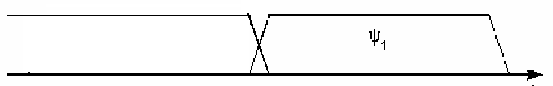
As we showed previously, the coefficients of Ψ₁ is just the band-passes filtered time-series, where Ψ₁ is the wavelet, now viewed as a bandpass filter.
This suggests a recursion. Replace:
ω
¹/₈ω_{ny}
¼ω_{ny}
½ω_{ny}
ω_{ny}
with
ω
low-pass filter
½ω_{ny}
ω_{ny}

Slide 19
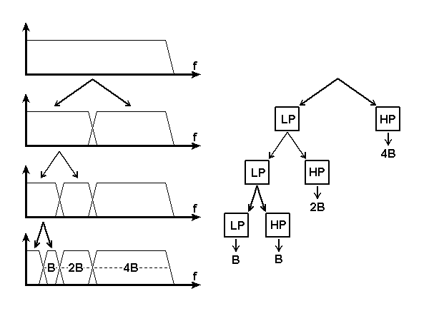
And then repeat the processes, recursively …

Slide 20
Chosing the low-pass filter
It turns out that its easy to pick the low-pass filter, f^{lp}(w). It must match wavelet filter, Ψ(ω). A reasonable requirement is:
|f^{lp}(ω)|² + |Ψ(ω)|² = 1
That is, the spectra of the two filters add up to unity. A pair of such filters are called Quadature Mirror Filters. They are known to have filter coefficients that satisfy the relationship:
Ψ_{N-1-k} = (-1)^{k} f^{lp}_{k}
Furthermore, it’s known that these filters allows perfect reconstruction of a time-series by summing its low-pass and high-pass versions

Slide 21
To implement the ever-widening time sampling τ_{j,k} = 2^{j}kΔt we merely subsample the time-series by a factor of two after each filtering operation

Slide 22
time-series of length N
Recursion for wavelet coefficients
HP
LP
↓2
↓2
γ(s₁,t)
HP
LP
γ(s₁,t): N/2 coefficients
γ(s₂,t): N/4 coefficients
↓2
↓2
γ(s₂,t): N/8 coefficients
γ(s₂,t)
HP
LP
Total: N coefficients
↓2
↓2
…
γ(s₃,t)

Slide 23
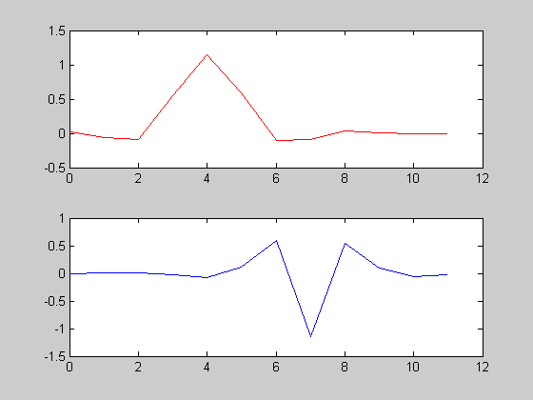
Coiflet low pass filter
time, t
Coiflet high-pass filter
time, t
From http://en.wikipedia.org/wiki/Coiflet

Slide 24
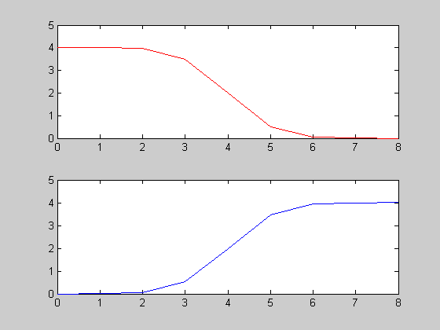
Spectrum of low pass filter
frequency, ω
Spectrum of wavelet
frequency, ω

Slide 25
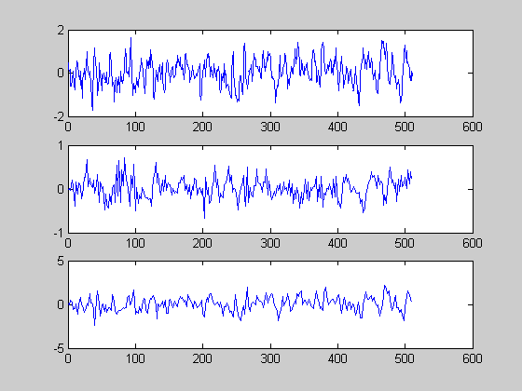
time-series
stage 1 - hi
stage 1 - lo

Slide 26
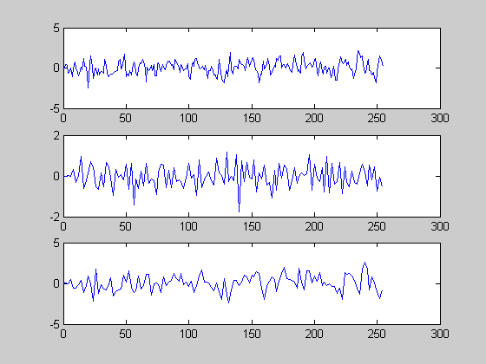
Stage 1 lo
stage 2 - hi
stage 2 - lo

Slide 27
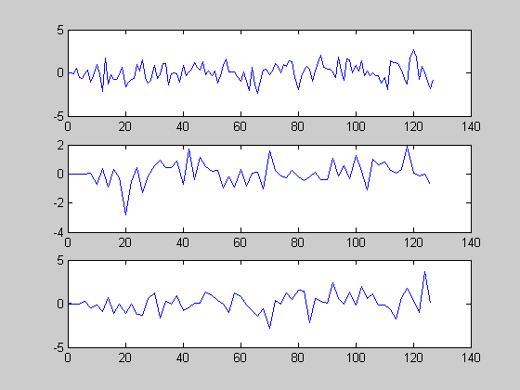
Stage 2 lo
stage 3 - hi
stage 3 - lo

Slide 28
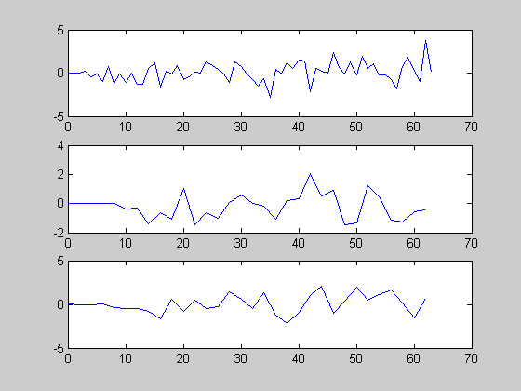
Stage 3 lo
stage 4 - hi
stage 4 - lo

Slide 29
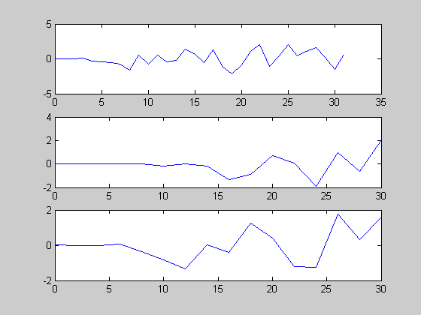
Stage 4 lo
stage 5 - hi
stage 6 - lo

Slide 30
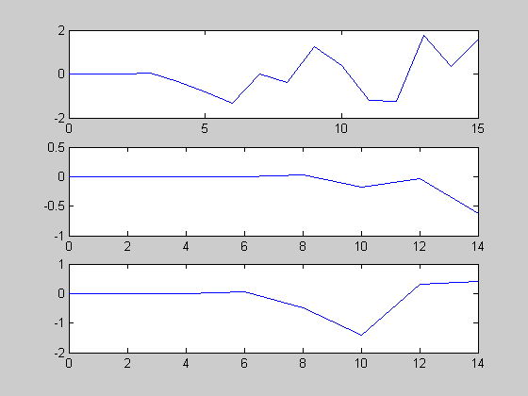
Stage 4 lo
stage 5 - hi
stage 6 - lo
Had enough?

Slide 31
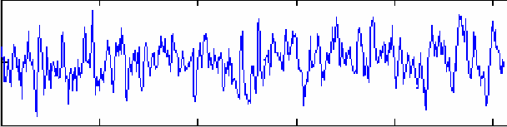
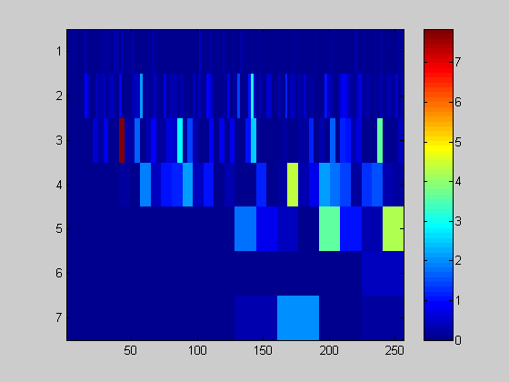
Putting it all together …
|γ(s_{j},t)|²
short
wavelengths
scale
long
wavelengths
time, t

Slide 32
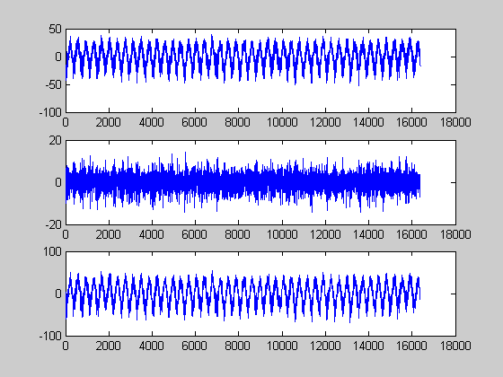
LGA Temperature time-series
stage 1 - hi
stage 1 - lo

Slide 33
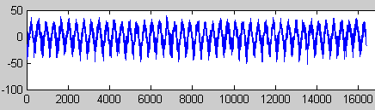
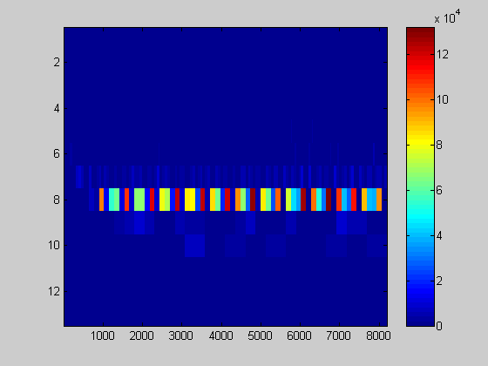
short
wavelengths
scale
long
wavelengths
time, t

